Slide 1
DIRECT SALE Opportunities

Slide 2
Opportunities FOR DIRECT SALE CHANNELS
Based on new state-of-the-art technologies and following new distribution developments, UIA is now offering travel professionals a free direct connect service to airline inventory, that delivers a reliable and rich content channel to our partners across the globe that provides a myriad of great benefits and opportunities:
Avoid additional channel (GDS) fees: 15 USD per segment, up to 60 USD for RT ticket with transit and 2 USD for additional services
Get access to special promotions and offers available exclusively through direct sales channels
Integrate UIA content using the NDC API into existing online booking tools and sales processes
Provide group sales with special conditions and receive dynamic prices
Make settlements through BSP or directly with UIA

Slide 3
Opportunities FOR DIRECT SALES
There are many opportunities for new distribution capabilities and each UIA partner can find the platform that works best for them in this presentation:
Solution for online travel agents and consolidators with their own booking platform
NDC API (New Distribution Capability) with the ability to connect UIA content to its own user interface, and expand service offerings and get new content and sales opportunities
Opportunities for retail agents
AIDL (Amadeus Inventory Direct Link) for travel professionals that are currently booking air
Opportunity for group sales
GRPM (Group Module)
Easylinkz Crazy Llama (В2В Plug In / В2В Core) + AIDL for agents who choose the best deal in different channels
UIA website + promo code for agents who prefer to book direct and earn benefits

Slide 4
NDC API solution for online travel agents
and consolidators

Slide 5
UIA NDC API. How does it work?
Amadeus HOST
Travel Agents and Aggregators
Travelers
NDC API (version 17.1/19.2) is a stand-alone solution providing a direct connection of the agent's booking channel to UIA content using the API connection
NDC API allows agents to provide their clients with air pricing and other services without additional fees and then be able to create their own pricing through different agency digital channels (B2B, B2C)
NDC API
- UIA partner providing NDC API technology solutions

Slide 6
UIA NDC API. Providing great opportunities.
Offer customers the best prices without additional channel or GDS fees
Improves look2book, booking experience and capabilities of online platforms by offering customers access to flight schedules and all UIA fare offers, including Fare Families and special fares
Book connecting flights with interline partners
Change dates, refunds and reissue tickets through the Amadeus AIDL interface
Receive a system response, in less than one second, (0.6 seconds) regarding flight availability on chosen dates and lowest fares (AirShopping WS)
Create custom mix-sell options and up-sell opportunities
Ongoing agent updates through UIA NDC Portal and information about the UIA NDC API platform
Access to UIA Help Desk support

Slide 7
UIA NDC API. Shopping Process
Basic services set for easy ticketing process
Shopping
Booking
Payment and ticketing
AirShoppingRQ
AirShoppingRS
UIA operated &
code-share flights
OrderCreateRQ
OrderViewRS
AirDocissueRQ
OrderViewRS
Refunds, date changes, reissues done via AIDL terminal
Additional services
Confirm pricing
PNR Retrieve
Fare Rules
FlightPriceRQ
FlightPriceRS
OrderRetriveRQ
OrderViewRS
FareRulesRQ
FareRulesRS

Slide 8
UIA NDC API. Post-Sale Process
Service List
Seat Availability
Order Change
ServiceListRQ
ServiceListRS
Ancillary catalogue with meals and bags
SeatAvailabilityRQ
SeatAvailabilityRS
Seat Map with pricing, seat characteristics and seat occupation
OrderChangeRQ
OrderViewRS
Add and remove ANC and seats from the PNR. Add and update DOCS and FQTV elements in the PNR
Order management services
Order Cancel 19.2
Query Report (TJQ)
OrderCancelRQ
OrderCancelRS
Cancel PNR, VOID issued documents
ReportQueryRQ
ReportQueryRS
Returns same data is available in the Amadeus TJQ report

Slide 9
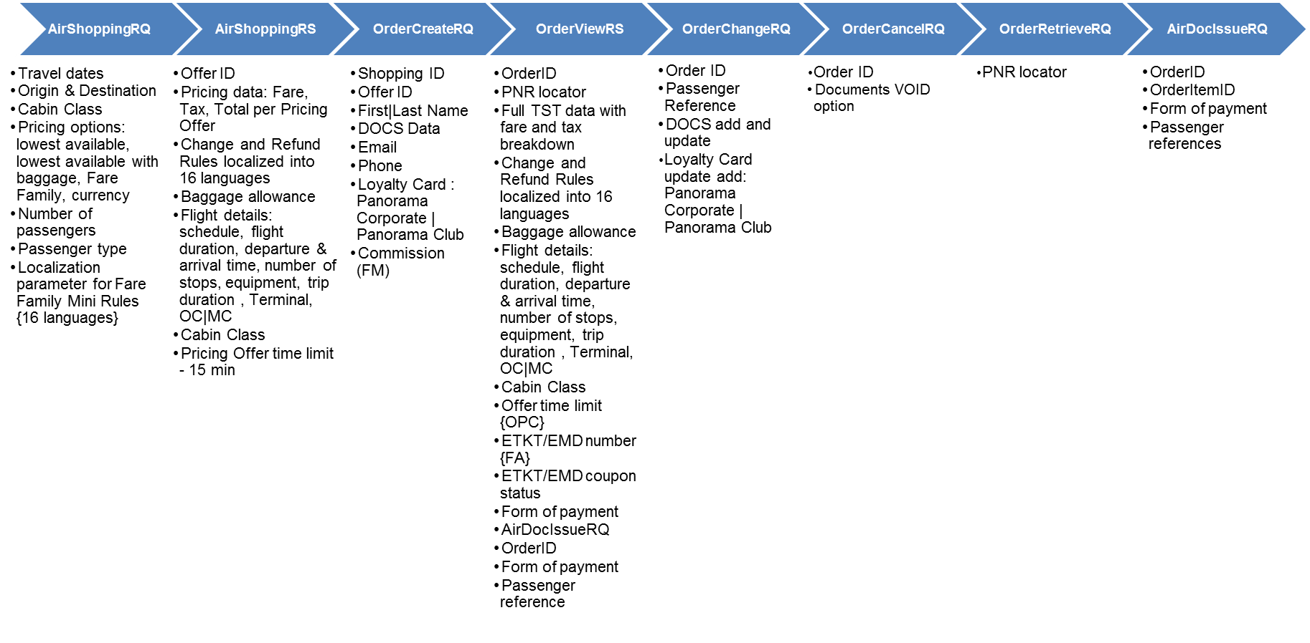
UIA NDC API. Shopping services Input/Output data

Slide 10
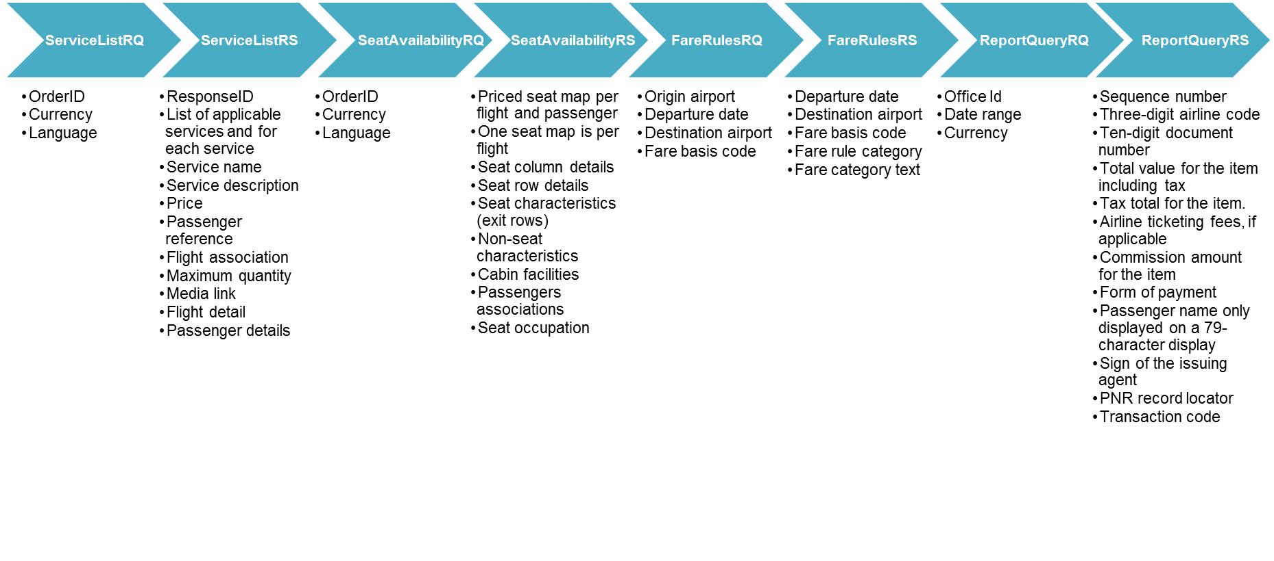
UIA NDC API. Post-Sale services Input/Output data

Slide 11
UIA NDC API. Road Map 2021
Add SEMN SSR to the PNR
Flight + Ancillary Offers within AirShopping Request Search (before PNR creation)
Q4 (December)

Slide 12
UIA NDC API. How to connect?
Contact SolringAir to get a link to NDC API Implementation Instructions and Sandbox Credentials (Test Environment)
Complete NDC API implementation and certification (takes up to 5 business days)
Sign the NDC API agreement with UIA
Get your AIDL office ID and wiki link
Fill out the user questionnaire and send it to UIA
Congratulations! You are ready to work in UIA NDC API
In order to connect contact your UIA manager or the UIA Help Desk at pshelpdesk@flyuia.com

Slide 13
AIDL opportunity for retail travel agents

Slide 14
UIA AIDL. How does it work?
AIDL is an Amadeus office ID, directly connected to the UIA Altea inventory, which offers the same functionality as the Amadeus GDS selling platform
Access is provided from any PC or mobile device, and has no international limits and is available worldwide for an unlimited number of users

Slide 15
UIA AIDL. Opportunities for Retail Travel Agents
Access to the schedule and availability of UIA and interline partner flights, price offers (with/without baggage), offline access to PNR
Offer customers the best prices without additional channel (GDS) fees
Change dates, issue refunds and reissue tickets
Use the Amadeus Ticket Changer (ATC) function with guaranteed calculation
Sell additional services (baggage, seats, meals) with EMD / EMD-A on UIA operated flights
Access daily sales reports
UIA Help Desk support

Slide 16
UIA AIDL. How to connect?
Receive from UIA the Amadeus office ID and access to AIDL, which will be automatically sent to your email address
Congratulations! You are ready to work in UIA AIDL
Sign an AIDL agreement with UIA
Fill out the user questionnaire
Submit a letter to Amadeus in order to create an AIDL Office ID (text will be provided)
In order to connect contact your UIA manager or the UIA Help Desk at pshelpdesk@flyuia.com

Slide 17
UIA website + promo code opportunity for retail travel agents

Slide 18
Agents sign up and receive a promo code from UIA with commercial conditions to sell tickets and additional services
Agents will use their exclusive promo code on www.flyuia.com website when booking flights and additional services
Sell UIA flights and additional services simply and conveniently without the need to connect to the booking system

Slide 19
Easylinkz Crazy Llama – An innovative opportunity for retail travel agents

Slide 20
Easylinkz Crazy Llama. How does it work?
The easiest tool to review and compare pricing from different channels & airlines
Easylinkz Crazy Llama is offered in two versions В2В Plug IN and В2В Core. Agent can select the option which best meets their needs.
В2В Plug IN - was developed for the experienced travel professionals in GDS bookings. Agent will receive and handle wall price searches imported from: GDS, NDC, API, and AGENTs that may have their own dedicated commercial contracts on one screen
В2В Core - graphical interface, which allows all agents to handle booking and ticketing without any GDS experience
The system creates automatically an analogue to IUR files for non-GDS products (including AIDL)

Slide 21
Easylinkz Crazy Llama. The opportunity for retail travel agents
Automatically receive and manage conditions/prices from different consolidators and BSPs (on the terms of separate agreements), and different pricing channels (GDS, NDC, API, Agents own dedicated commercial contracts)
Manage the total price incorporating GDS fees, agency mark-ups, bonuses and have it reflected in final customer invoice and also in agency accounting system (NB the client does not see the agent's profit in their e-ticket)
Time efficient with the booking, confirmation and ticketing taking less than 10 minutes
Various payment options: Credit card / Deposits
Get online support from Easylinkz Help Desk 24/7

Slide 22
Easylinkz Crazy Llama. How to connect?
Easylinkz connects and informs the Agent about connection readiness and conducts training (if necessary)
Congratulations! You are ready to work in Easylinkz Crazy Llama
Sign an AIDL / NDC agreement with UIA and an agreement with Easylinkz to use the solution and Easylinkz Help Desk support
In order to connect contact your UIA manager or the UIA Help Desk at pshelpdesk@flyuia.com or Easylinkz Help Desk sales@easylinkz.com

Slide 23
GRPM New group sales opportunity for tour operators and group planners

Slide 24
UIA GRPM. New Group Opportunities
Track and manage all group bookings using a simple interface
Generate direct group sales with favorable terms and rates
Instantly receive a guaranteed price for a flight without prepayment by filling out a simple request form
Receive dynamic pricing, along with alternative flights and dates options to work within budgets.
Change names and surnames of travelers an unlimited number of times until the tickets are issued
Book additional services
Get UIA Help Desk support

Slide 25
UIA GRPM. How to connect?
If you are an IATA travel agent, go to https://groups.flyuia.com and select the appropriate option to register
If you are a NON IATA travel agent or retail customer (GROUP PLANNER), go to https://groups.flyuia.com and select the appropriate option to register
In order to connect contact your UIA manager or your UIA Group manager at group.dep@flyuia.com

Slide 26
UIA GRPM. New group opportunities
IATA travel agent
• Possibility to issue a ticket in the agent's own AIDL office or in the module
• Payment by issuing EMD in BSP link or payment by bank account
• PNR retrieval (access to booking in own remote control)
• Sales are included in total agency sales
• Access to all group bookings
NON IATA travel agent / retail customer (GROUP PLANNER)
• Payment by bank account
• Access to booking for making changes through the UIA Contact Center

Slide 27
Contact & Support

Slide 28
Contact & Support
Do you have questions?
Get more information at UIA Direct Channels Information Portal
Contact your UIA sales manager, or UIA Help Desk
UIA Help Desk
Tel: +38 (044) 581-51-45
E-mail: pshelpdesk@flyuia.com

Slide 29
UIA appreciates all of our travel partners
We will continue to keep you updated on UIA news and provide you with the best support to help grow your business and find new ways to grow sales together.
Please contact your regional UIA sales manager to discuss future cooperation on any of these exciting new NDC programs or platforms.

